Slide 1

Basic Math
A day in the life of Alex
Notes:
Introductions (Brandon Fecht, Wake Tech ILC)
Session description
Open for questions at the end of every problem

Slide 2
Alex’s Itinerary
Work
Shopping
Check bank
Gas station
Eat dinner
Housework
Read newspaper
Check mail
Notes:
Office job
2) There’s a sale at their favorite store
3)
4)
5) Salad
6) Thinking about repainting their living room
7) It’s how they relax

Slide 3
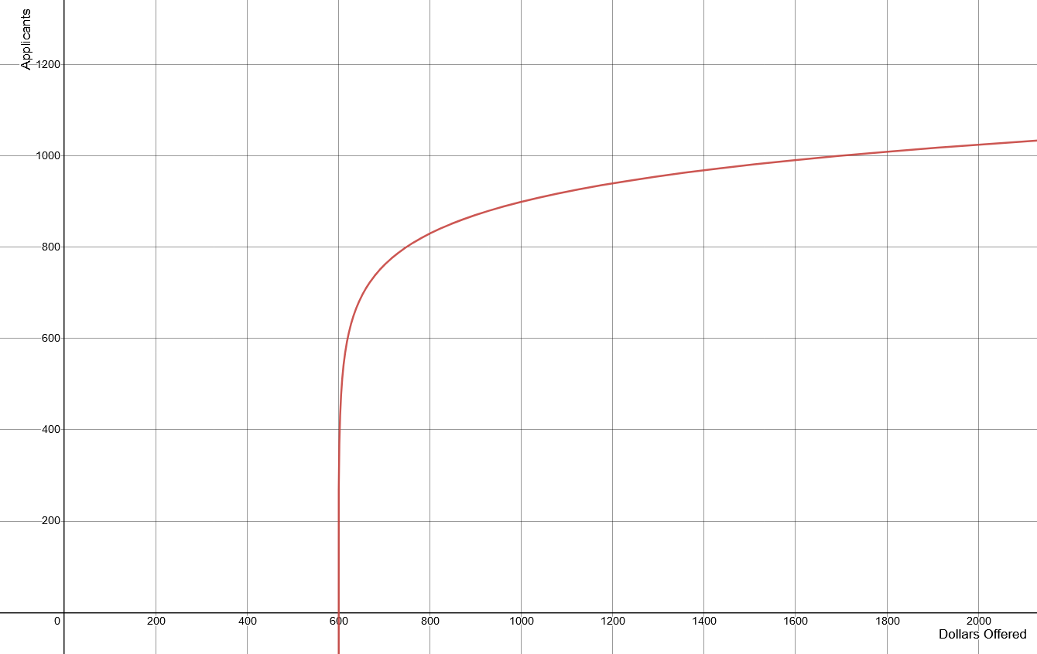
Work
“How any applicants will we get if we offer $1,000?”
900 applicants

Slide 4
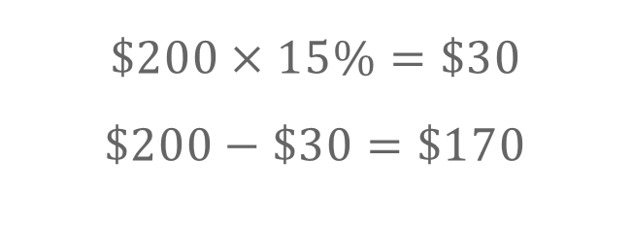
Shopping
10% off
15% off
25% off
$200
$$\$200×15\%=\$30$$
$$\$200−\$30=\$170$$

Slide 5

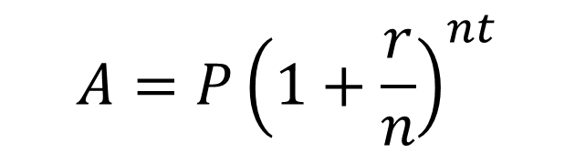

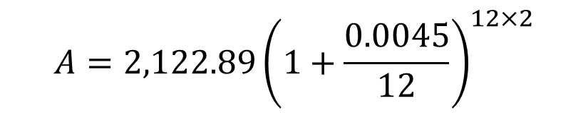
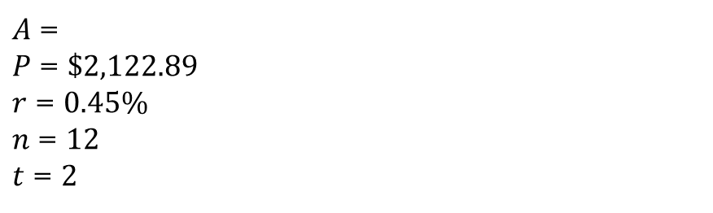
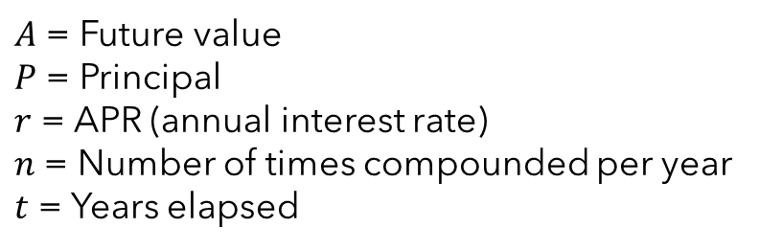
Check bank
How much money will Alex have in 2 years?
$A$ = Future value
$P$ = Principal
$r$ = APR (annual interest rate)
$n$ = Number of times compounded per year
$t$ = Years elapsed
“All accounts are compounded monthly”
$$A=P{\left(1+\frac{r}{n}\right)}^{nt}$$
$$A=2,122.89{\left(1+\frac{0.0045}{12}\right)}^{12×2}$$
$A$ =
$P$ = $\$2,122.89$
$r$ = $0.45\%$
$n$ = $12$
$t$ = $2$
$$A=2142.08$$

Slide 6
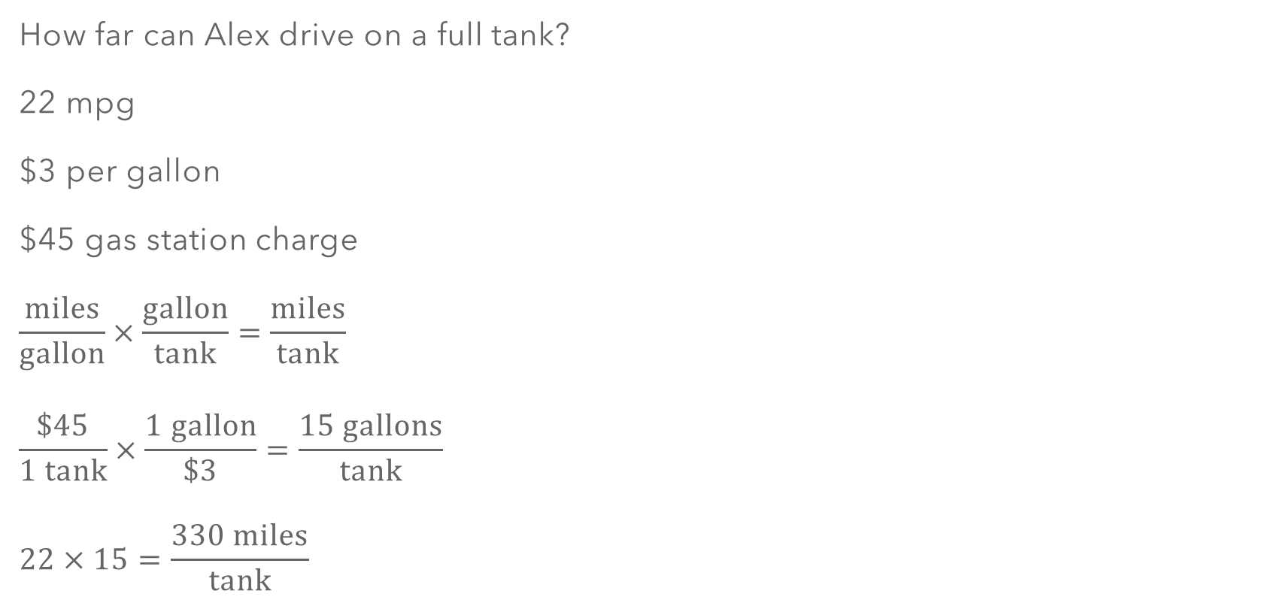
Gas station
How far can Alex drive on a full tank?
22 mpg
$3 per gallon
$45 gas station charge
$$\frac{\text{miles}}{\text{gallon}}×\frac{\text{gallon}}{\text{tank}}=\frac{\text{miles}}{\text{tank}}$$
$$\frac{\$45}{1 \text{tank}}×\frac{1 \text{gallon}}{\$3}=\frac{15 gallons}{\text{tank}}$$
$$22×15=\frac{330 miles}{\text{tank}}$$

Slide 7
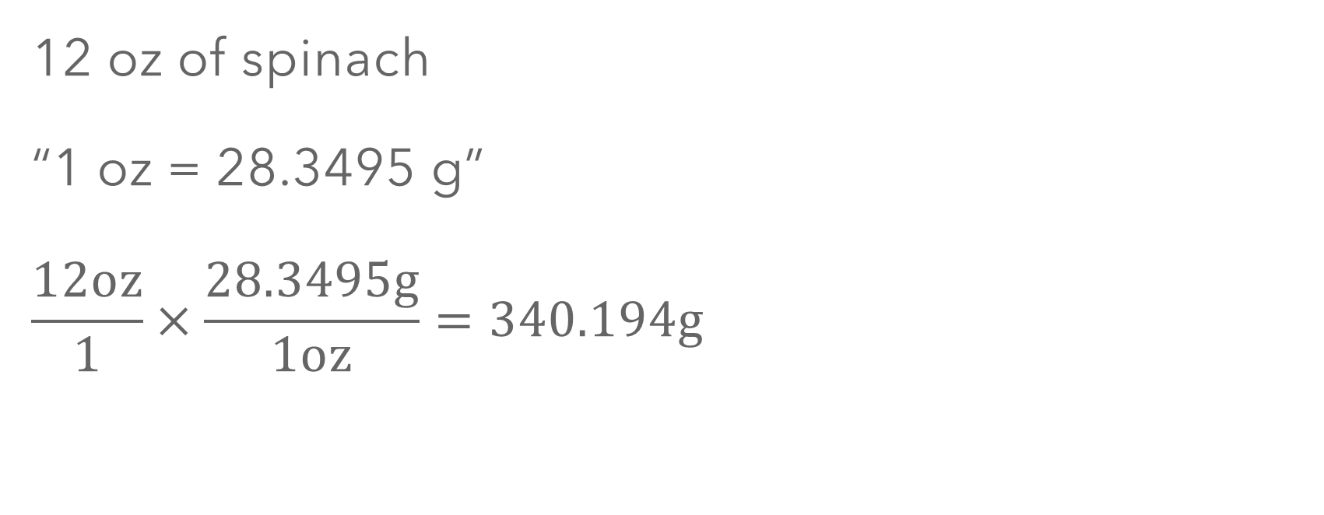
Eat dinner
12 oz of spinach
“1 oz = 28.3495 g”
$$\frac{12\text{oz}}{1}×\frac{28.3495\text{g}}{1\text{oz}}=340.194\text{g}$$

Slide 8



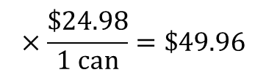

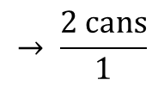



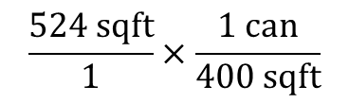

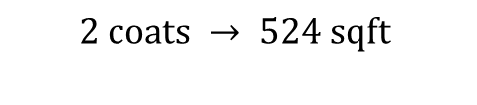
Housework
8ft
12ft
3ft
8ft
8ft
8 ft ceilings
7ft
12ft
8ft
12ft
8ft
8ft
3ft
8ft
4ft
8ft
7ft
4ft
12ft
$$8×8×2$$
$$+ 12×8×2$$
$$− 4×4$$
$$− 3×7×2$$
$$=262 \text{sqft}$$
$$\text{2 }\text{coats} → \text{524 }\text{sqft}$$
$$\frac{524 \text{sqft}}{1}×\frac{1 \text{can}}{400 \text{sqft}}$$
$$→ \frac{\text{2 }\text{cans}}{1}$$
$$×\frac{\$24.98}{\text{1 }\text{can}}=\$49.96$$
$$=1.31 \text{cans}$$

Slide 9
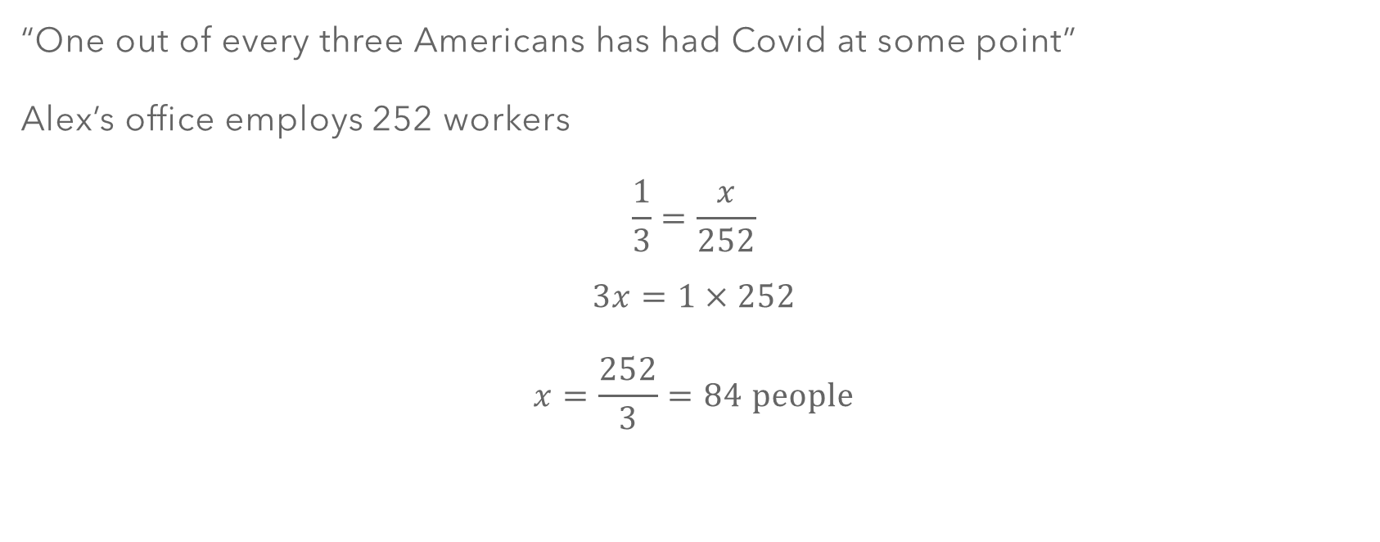
Read Newspaper
“One out of every three Americans has had Covid at some point”
Alex’s office employs 252 workers
$$\frac{1}{3}=\frac{x}{252}$$
$$3x=1×252$$
$$x=\frac{252}{3}=84 \text{people}$$

Slide 10


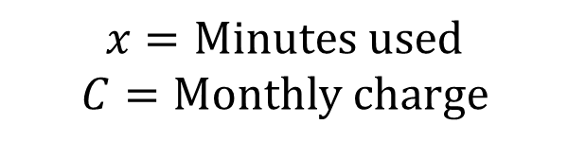
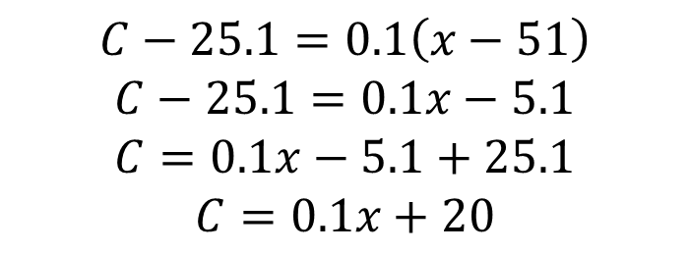

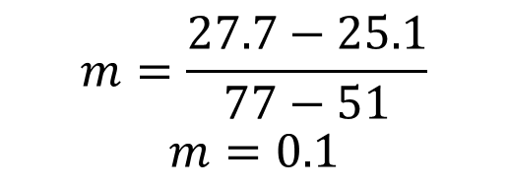


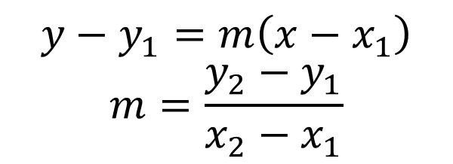

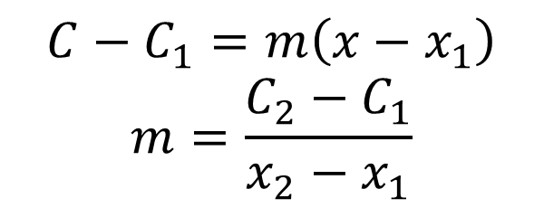
Check mail
$$y−y_{1}=m\left(x−x_{1}\right)$$
$$m=\frac{y_{2}−y_{1}}{x_{2}−x_{1}}$$
$$C−C_{1}=m\left(x−x_{1}\right)$$
$$m=\frac{C_{2}−C_{1}}{x_{2}−x_{1}}$$
$$x=\text{Minutes} \text{used}$$
$$C=\text{Monthly} \text{charge}$$
$$m=\frac{27.7−25.1}{77−51}$$
$$m=0.1$$
$\left(x_{1},C_{1}\right)$=
$$(51, 25.1)$$
$$C−25.1=0.1\left(x−51\right)$$
$$C−25.1=0.1x−5.1$$
$$C=0.1x−5.1+25.1$$
$$C=0.1x+20$$
$$(77, 27.7)$$
$\left(x_{2},C_{2}\right)$=

